Slide 1
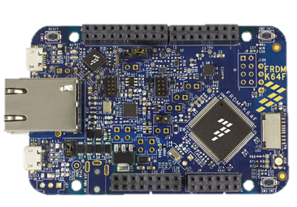

E+
Reference Voltage
S+
S-
3.3 V
E-
1
16
LOAD CELL
A_{out} = 0 - 3.3 V
Diff
Input
Ground
6.2 $Ω$
Other
Load
cells
INA125P
FRDM K64F

